Slide 1
Notes:
Intro
Title: Catastrophic Failures: Tales from the Trenches – Synacor (this is public info)
Richard Kenyan
In the IT Industry for ~20 years

Slide 2
Catastrophic Failure: Tales from the Trenches
Richard Kenyan
vExpert 2018, 2019, 2020
BuffaloVMUG Co-Leader
VMUG US-East Regional Champion Leader
Twitter/LinkedIn: @RichardKenyan
Notes:
Intro
Title: Catastrophic Failures: Tales from the Trenches – Synacor (this is public info)
Richard Kenyan
In the IT Industry for ~20 years
INTRO MYSELF
Anticipatory set: Ever been at a bar with co-workers and soon you start swapping war stories from IT?
Well, here’s your beer…
FLIP TO NEXT SLIDE
Start telling WHOLE story with beer pic, then walk-through it.

Slide 3

Notes:
Tell the WHOLE story here, then tell them you’ll walk them through the whole thing.
Opal(121) + Zimbra(255) = 376
DAL_PROD(626)
376 + 626 = 1,002 total

Slide 4
Uh oh….
Triage Time
Figure out what happened. What just broke?
What can I hit?
vCenters
Storage
Admin boxes
Location/Scope?
What DC? What Cluster?
Which clients are down?
NOC Assistance
What do you see?

Slide 5

Lots of red!
Something broke!

Slide 6

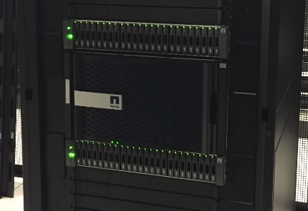
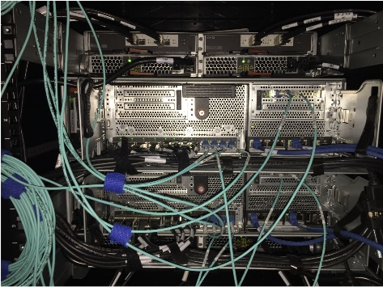
Where is the stack broken?
DC
Storage
Power
Network
Block/File
FC
Ethernet
Storage
Infrastructure
Object
Block/File
Servers
Physical
VMware
GuestOS
CentOS
Windows
Notes:
NODE 2 – dimm replacement
NODE1 – rebooted due to panic after takeover. Came back-up fine in about ~90 seconds.

Slide 7

Troubleshooting
Storage
What pieces have failed?
What Volumes are down?
Are the Network Interfaces ok?
Are the HBAs ok?
Have SYSADS check DNS
vCenter/PSC
When it goes RO, you have to fsck both manually
Teams
Incident Manager
NOC
DBA
SYSADS
EMAILOPS
WEBOPS + VAM
STORAGE
NETWORK

Slide 8
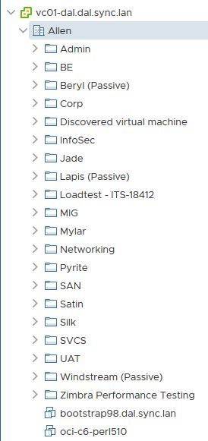
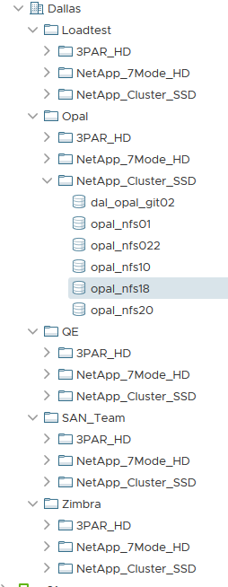
Troubleshooting
DAL VMs ON NETAPP DEVICE
OPAL DATASTORES ACROSS MULTIPLE STORAGE DEVICES

Slide 9
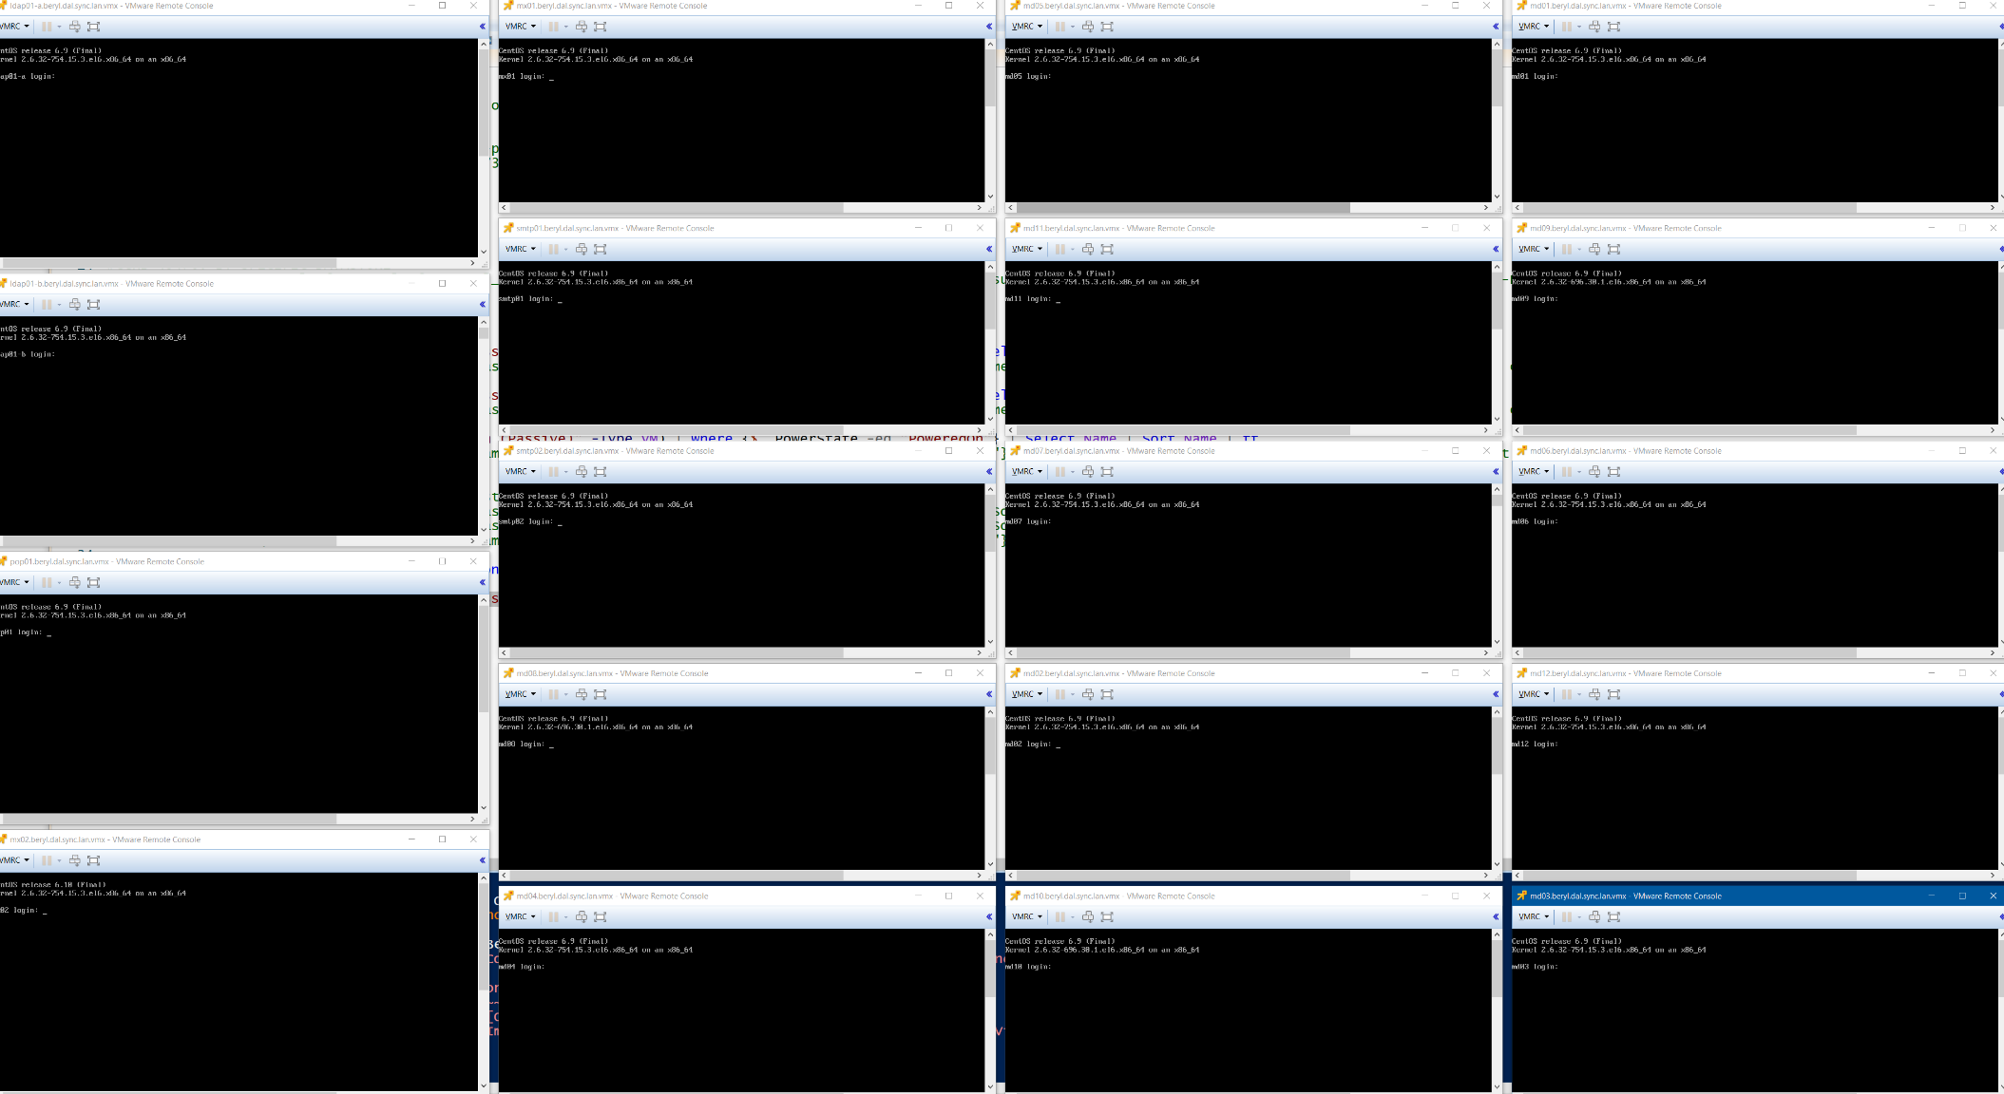
PowerCLI to find RO VMs
Notes:
I use the VMRC because it brings up a separate Windows Taskbar Icon, which can then be cascaded, stacked, or side-by-side.
Using the browser version works fine, but it’s hard to parse out and view a bunch of windows at the same.

Slide 10
Timeline from NetApp
DAL – NetApp – controller DIMM replacement – failover failed
Node 2 DIMM RMA: Thu Oct 03 19:05:27 EDT
Memory DIMM in slot 3 went bad and work started to replace it
Node 1 Panic: Thu Oct 03 19:48:39 EDT
From a core file generated by node 1 it was determined the reboot was due to bug 1078977, fixed in 9.2P3 (you are currently on 9.2P1)
Node 2 Root Vol Issue: Oct 03, 2019 22:52:35 EDT
Oct 03 22:21:30 [dalclt01-02:callhome.root.vol.recovery.reqd:EMERGENCY]: Call home for ROOT VOLUME NOT WORKING PROPERLY: RECOVERY REQUIRED.
Node 2 was halted and environment variables were confirmed and root volume recovery was started
Node 1 Brought back up: Oct 03, 2019 22:52:29 EDT
Giveback was performed

Slide 11
Bug 1078977 from NetApp
Check the current value of the "membership reports sent"
::*> set diag
::*> systemshell -c "sudo jexec Cluster netstat -s | grep 'membership reports sent'" -node <nodename>
If the number of membership reports sent is 1,000 or above, this indicates this node is vulnerable to the panic. If the value is 0 then the node is not currently exposed, and you do not need to proceed with the workaround.
bosclt01::*> systemshell -c "sudo jexec Cluster netstat -s | grep 'membership reports sent'" -node bosclt01-01
(system node systemshell)
448 membership reports sent
bosclt01::*> systemshell -c "sudo jexec Cluster netstat -s | grep 'membership reports sent'" -node bosclt01-02
(system node systemshell)
1920 membership reports sent

Slide 12

Contact Info
Twitter/LinkedIn: @RichardKenyan
Email: rkenyan@gmail.com
I have GitHub setup!
https://github.com/richardkenyan
Thanks!
Richard Kenyan
vExpert 2018, 2019, 2020
BuffaloVMUG Co-Leader

